Slide 1





The Simpler The Better: A Unified Approach to Predicting Original Taxi Demands based on Large-Scale Online Platforms
Yongxin Tong¹, Yuqiang Chen², Zimu Zhou³, Lei Chen⁴, Jie Wang⁵, Qiang Yang^{2,4}, Jieping Ye⁵, Weifeng Lv¹ ¹ SKLSDE Lab, Beihang University, ⁵ Didi Chuxing, ² 4Paradigm Inc., ⁴ Hong Kong University of Science and Technology, ³ ETH Zurich
Notes:
Hi everyone, I am Jieping Ye. Today I’ll present our work on a unified approach to predicting original taxi demands based on large-scale online platforms.
It is a joint work with Beihang University, 4Paradigm Inc., ETH, HKUST and DiDi Research.

Slide 2
Outline
Background and Motivation
Key Methodology
Feature Engineering
Our Model
Model Training Processing
Experimental Study
Conclusion
Notes:
This is the outline

Slide 3
Outline
Background and Motivation
Key Methodology
Feature Engineering
Our Model
Model Training Processing
Experimental Study
Conclusion
Notes:
This is the outline

Slide 4


The Story of AI Engineer Andy
Predict Original Taxi Demand (OTD)
Notes:
Let’s take an AI engineer Andy, as an example.
His recent task is to predict original taxi demands, or OTD, for a large-scale online taxi calling platform.

Slide 5
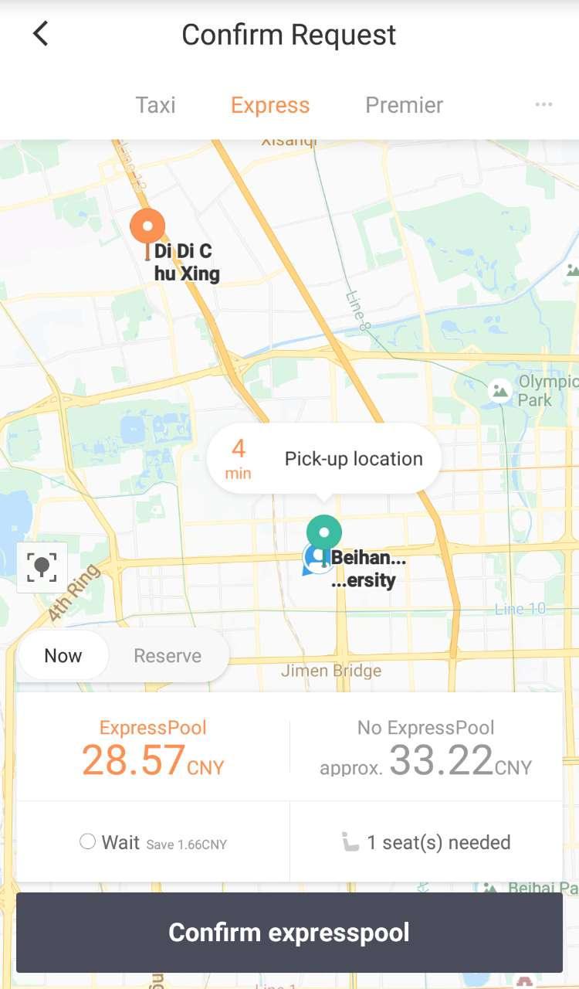


What is OTD?
I need to
call a taxi…
Notes:
So what is original taxi demand or OTD?
Look at this picture. It is very inconvenient for a pregnant lady to walk home in a rainy day. So she opens her App and calls a taxi. This is one example of taxi demand.

Slide 6


What is OTD?
I can wait
no more…
OTD： The number of taxi-calling orders submitted to the online taxicab platform
Notes:
On the same raining day, a man first decides to call a taxi to work, but finally decides to cancel the request and walk to work because of the high price.
Even though his taxi-calling order is cancelled, it is still an example of original taxi demand or OTD.
That is, OTD refers to all the taxi-calling orders submitted to the online taxicab platform.

Slide 7
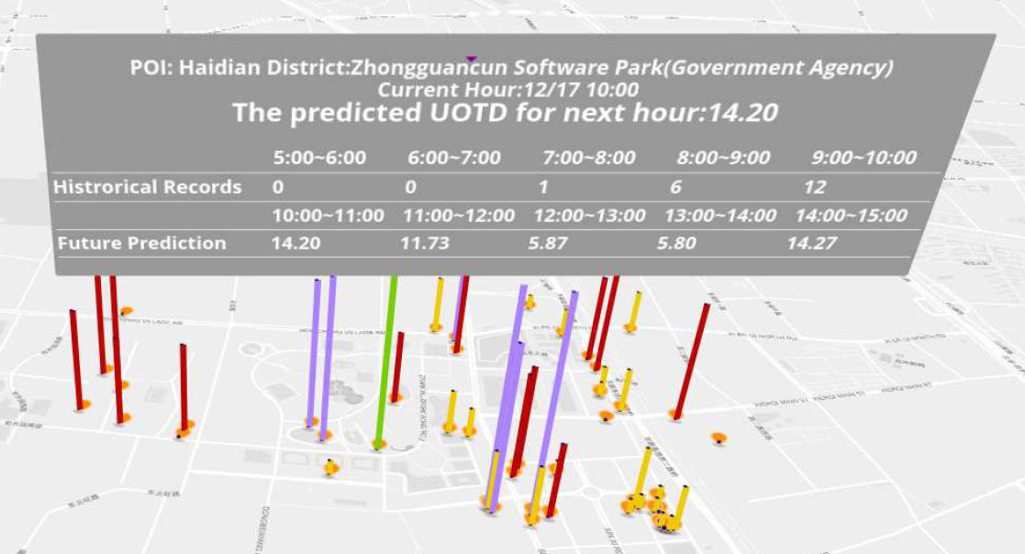
UOTD
Unit Original Taxi Demand (UOTD)
UOTD： The number of taxi-calling orders submitted to the online taxicab platform per unit time and per unit region
Notes:
In practice, the OTD of an online taxicab platform is reflected by the Unit Original Taxi Demand, also known as UOTD, which is original taxi demands for each point of interest and for each unit time slot.
This is a screenshot showing the predicted amount of OTD at different POIs during different time slots in Beijing.

Slide 8


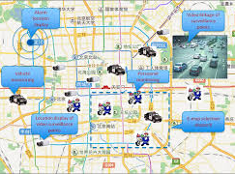
Applications of UOTD
Expand Potential Market
Assess Incentive Mechanisms
Guide Taxi Dispatching
Notes:
So why does an online taxicab platform need UOTD?
With UOTD, an online taxicab platform can expand potential market, assess incentive mechanisms and guide taxi dispatching.

Slide 9
Outline
Background and Motivation
Key Methodology
Feature Engineering
Our Model
Model Training Processing
Experimental Study
Conclusion
Notes:
This is the outline

Slide 10


Two Paradigms
Complex (non-linear) models
Simple (linear) models
V.S.
A few features
Massive features
Notes:
Now back to our engineer Andy. Given the task to predict UOTD, which approach will he apply?
There are in fact two paradigms to choose from: one is to design complex models with a few features, and the other is to use simple models with massive features.

Slide 11

Model Redesign
Complex (non-linear) models
A few features
Labor-intensive Model Redesign
Difficult to Design Comprehensive Models
Notes:
There are two main reasons why model redesign is not preferred in industries.
On the one hand, it is difficult to design a model that reflects all the joint dependencies among features for accurate prediction.
On the other hand, with the expanding of market, business logics may change, or more data sources will become accessible. To keep up with these new factors, frequent model redesign is unavoidable, which unfortunately can be quite labor-intensive for our AI engineers.

Slide 12

Feature Redesign
Simple (linear) models
Massive features
Use Combinational Features!
Superiority
Notes:
However, with the second paradigm, engineers only need to analyze the new business logics carefully and combine new features. In other words, all these efforts can be replaced by feature redesign using combinational features.

Slide 13
Feature Redesign
Simple (linear) models
Massive features
Use Combinational Features!
The Simpler, The Better
Superiority
Notes:
That is, our experiences tell us that “The Simper, The Better”.

Slide 14
Two Paradigms
Complex (non-linear) models
Simple (linear) models
V.S.
A few features
Massive features
Transform Model Redesign
to Feature Redesign
Notes:
From an engineering perspective, the second paradigm is better, because it transforms model redesign to feature redesign.

Slide 15
Outline
Background and Motivation
Key Methodology
Feature Engineering
Our Model
Model Training Processing
Experimental Study
Conclusion
Notes:
This is the outline

Slide 16
Feature Engineering
Basic
Features
Features
Combinational
Features
Notes:
To predict UOTD, we start with some basic and intuitive features and then explore effective combinations of the basic features.

Slide 17
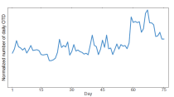
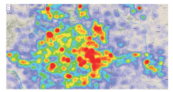
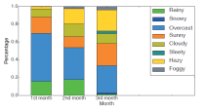
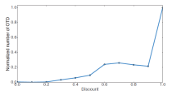
Basic Features
Temporal
Features
Spatial
Features
Basic
Features
Meteorological Features
Event
Features
Notes:
From our analysis with massive datasets, we find features in the time, space, meteorology and events will notably affect UOTD. Therefore we select basic features from these 4 domains.

Slide 18
Basic Features
Temporal Features
Spatial Features
Meteorological Features
Event
Features
Month
District
Weather condition
Discount pricing strategy
Day of month
POI ID
Temperature
Even-odd license plate plan
Day of week
POI category
Wind
Version of the App
Hour of day
Distance distribution
Humidity
Holiday
Air Quality
Historical UOTD
Notes:
The detailed features of the basic features are shown here.
Take temporal features as an example, we choose features of Month, Day of month, Day of week, Hour of day, Holiday and Historical UOTDs.
Detailed meanings of the features are as follows:
Month: The month which the time interval is in
Day of month: The ordinal number of the day in a month
Day of week: The ordinal number of the day in a week
Hour: The time interval in a day
Holiday: The length of the holiday (e.g., Saturday is in a two-day holiday)
Historical UOTD: The UOTD of the same POI of the same time period in the last N days
District: The administrative district which the POI belongs to
POI ID: The ID of the POI that the location is associated with
POI category: The three-level category of the POI (后续29页的Entertainment Place属于此类特征)
Distance distribution: The distribution of the estimated taxi-ride distances from the POI
Weather condition: The description of the weather condition in a time interval
Temperature: The temperature measured by Celsius in a time interval
Wind: The orientation and speed of the wind in a time interval
Humidity: The index of humidity in a time interval
Air quality: The discretized six levels of the air quality in a time interval
Discount pricing strategy: The discount pricing strategy adopted by the online taxicab platform
Even-odd license plate plan: Traffic restrictions on the last digit of the license plate numbers （限号）
Version of the App: The version of the taxi-calling App

Slide 19
Combinational Features
Basic Features
Business Logics
Combinational Features
Notes:
For accurate prediction, we also need combinational features.
The combinational features are obtained from the analysis of business logics.
As next we show three examples of combination features that are effective in predicting UOTD.

Slide 20
Combinational Features
Example 1
Temporal
Temporal
Notes:
The first is to combine temporal features with temporal features.

Slide 21
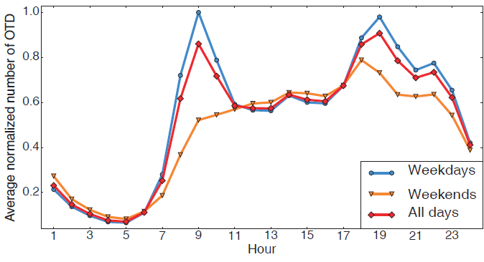
Combinational Features
Distribution of the normalized hourly taxi demands during weekdays, weekends, and for all days.
Notes:
This figure shows the distribution of the normalized hourly taxi demands during weekdays, weekends, and for all days.

Slide 22
Combinational Features
Insights from data analysis
Weekdays:
Two peaks
UOTD is influenced by
Day of week and Hour of day
jointly
Weekends:
One peak
Notes:
We see that there are two peaks in UOTD in 24 hours on weekdays. But there is only one peak at weekends.
Thus, UOTD is jointly influenced by Day of week and Hour of day.
Both Day of week and Hour of day are temporal features, which indicates that temporal features should be combined with itself.

Slide 23
Combinational Features
Example 2
Temporal
Spatial
Notes:
The second example is about combining temporal features with spatial features.

Slide 24
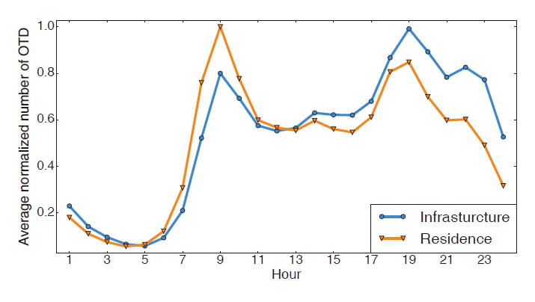
Combinational Features
Average hourly normalized taxi demands of two categories of POIs
Notes:
This figure shows the average hourly normalized taxi demands of a Residence-category POI and an Infrastructure-category POI.

Slide 25
Combinational Features
Insights from data analysis
Infrastructures:
More at evening peak
UOTD is influenced by
Typo of POIs and Hour of day
jointly
Residences:
More at morning peak
Notes:
We find the in the Infrastructure-category POI, there are more demands at the evening peak and the peaks holds for hours. However, in the Residence-category POI, more demands are at the morning peak, and the peak time is shorter.
Therefore we conclude that UOTD is jointly influenced by Type of POIs and Hour of day. Thus, temporal features and spatial features should be combined.

Slide 26
Combinational Features
Example 3
Meteorological
Spatial
Notes:
The last example is about combining meteorological features with spatial features.

Slide 27
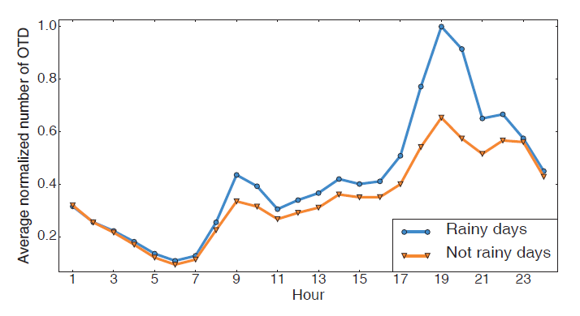
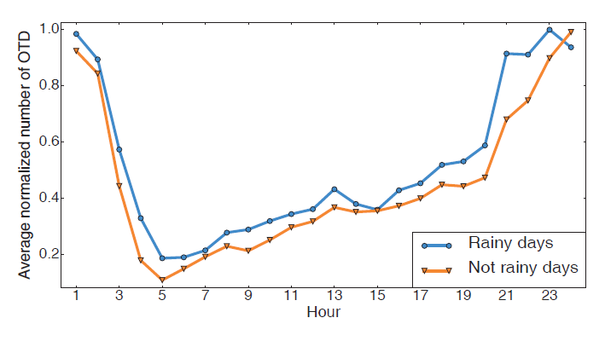
Example Features
An Entertainment Place (e.g., a bar)
An Airport
Average hourly normalized taxi demands of an entertainment place and an airport in rainy and non-rainy days
Notes:
These two figure show the average hourly normalized taxi demands of an entertainment place and an airport in rainy and non-rainy days

Slide 28
Example Features
An Entertainment Place (e.g., a bar)
An Airport
Different Weather conditions
have different influences on
different Types of POIs
Notes:
It can be seen that different weather conditions have different influences on different types of POIs.
Specifically, the UOTD of an airport is not notably influenced by rain. However, at the entertainment place, the UOTD is obviously influenced by rain, particularly during 17:00 to 22:00, when many people tend to hang out.

Slide 29
Example Features
An Entertainment Place (e.g., a bar)
An Airport
UOTD is influenced by
Type of POI and Weather condition
jointly
Notes:
Thus, UOTD is jointly influenced by Type of POI and Weather conditions, and Meteorological features and spatial features should be combined.

Slide 30




Feature Engineering
Features
200+ Million Dimensions
in Total
Temporal Features
Basic Features
Spatial Features
Meteorological Features
Event Features
Temporal-Temporal
Combinational Features
Temporal-Spatial
Meteorological-Spatial
Others
Notes:
These are just three examples of the combinational features used in our UOTD prediction.
Here is an overview of the entire feature engineering. In total, we come up with features of more than 200 million dimensions.

Slide 31
Outline
Background and Motivation
Key Methodology
Feature Engineering
Our Model
Model Training Processing
Experimental Study
Conclusion

Slide 32

Our Model
A linear regression model
the prediction
result
the feature vector
the parameter vector to be learned
Notes:
Since we exploit massive features, here we only use a linear model for prediction.

Slide 33
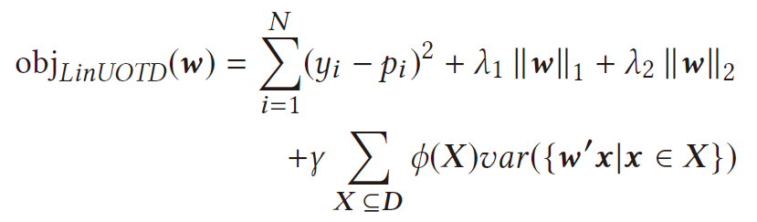
Our Model
A linear regression model
The objective function
a spatiotemporal regularizer
Notes:
This is our objective function, which includes both L1 and L2 normalization. Besides, to be fit for UOTD prediction, we propose further a spatiotemporal regularizer.

Slide 34
Our Model
A linear regression model
The objective function
Real-world UOTD records close in space or time tend to be similar
Notes:
It is based on the fact that UOTD close in space or time tends to be similar.
(X是来自训练数据D的一组采样，ϕ(X)表示这组采样数据所来自的时空位置的相似程度，var ()是计算方差的函数。这里的意思是，对于采样X，如果通过ϕ(X)计算出来的时空相似程度很高，即这组数据来自相近时间的相近POI，则var ()计算出来的方差应较低）
原文：where var () denotes the variance, X is a subset sampled from D, and ϕ(X) maps subsets of POIs and times to a real value which controls the regularization of prediction variance of instances x in X.)

Slide 35
Outline
Background and Motivation
Key Methodology
Feature Engineering
Our Model
Model Training Processing
Experimental Study
Conclusion
Notes:
This is the outline

Slide 36
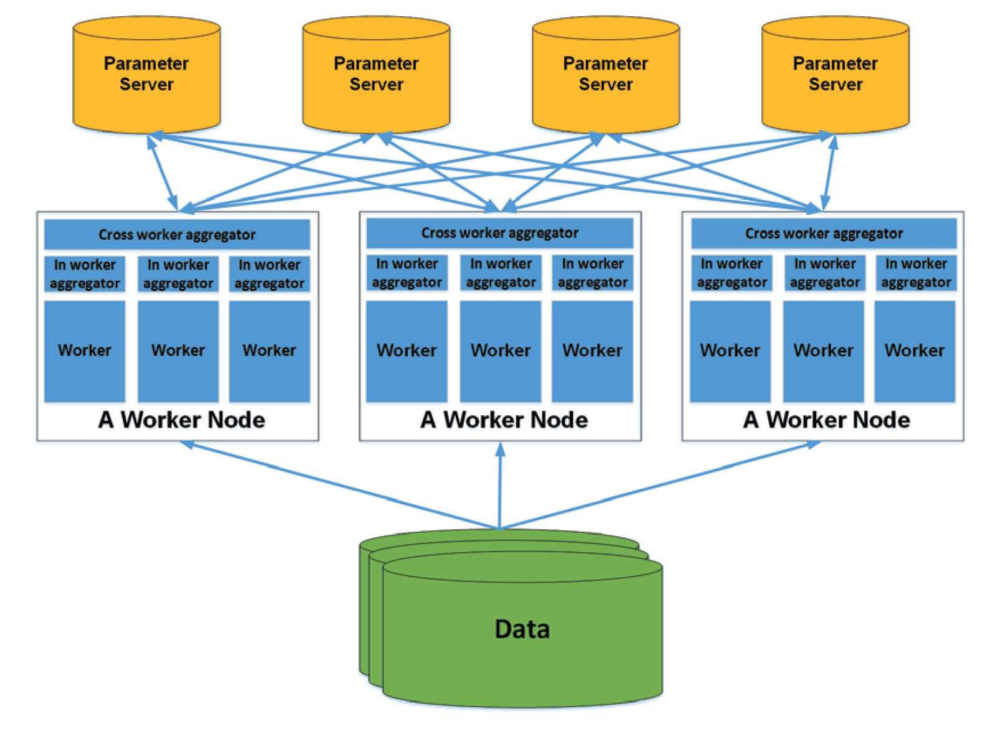
Distributed Learning Framework
How to tame so high dimensions?
Notes:
Although we only have a linear model, there are features of over 200 million dimensions.
To train a model with such high dimensions, a distributed learning framework based on parameter server is used.

Slide 37
Distributed Learning Framework
Model parameters are stored evenly and distributively among the parameter servers
Notes:
This part is the parameter servers, where model parameters are stored evenly and distributively.

Slide 38
Distributed Learning Framework
Training data are dispatched to each work node when the training process starts
Notes:
This part is the worker nodes. Training data are dispatched to each work node when the training process starts.

Slide 39
Distributed Learning Framework
Each work node runs multiple parallel workers， analyzing the training samples in minibatches
Notes:
During the training process, Each work node runs multiple parallel workers, analyzing the training samples in minibatches.

Slide 40
Distributed Learning Framework
Fetch the corresponding parameters from the parameter servers
Notes:
And the worker nodes will fetch the corresponding parameters from the parameter servers.

Slide 41
Distributed Learning Framework
Newly calculated gradients will be pushed to the corresponding parameter servers
Notes:
Finally, newly calculated gradients will be pushed to the corresponding parameter servers.

Slide 42
Outline
Background and Motivation
Key Methodology
Feature Engineering
Our Model
Model Training Processing
Experimental Study
Conclusion
Notes:
This is the outline

Slide 43
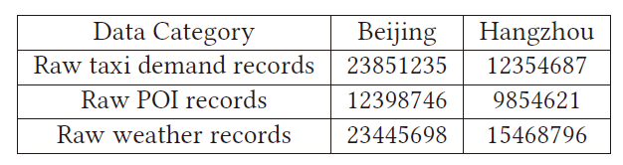
Experimental Study
Datasets
Baselines
Historical Average (HA)
ARIMA
Markov
GBRT
Neural Network (NN)
HP-MSI (GIS 2015)
Notes:
Finally we come to the evaluations.
The experiments are conducted on two datasets sampled from two cities in China.
Six baselines are compared. Particularly, the last one, namely HP-MSI is a method to predict the number of bikes to be rent from or returned
to each bike station.

Slide 44



Experimental Study
Metrics
Error Rate (ER)
Symmetric Mean Absolute Percent Error (SMAPE)
Root Mean Squared Logarithmic Error (RMLSE)
Notes:
We use three metrics: Error Rate (ER), Symmetric Mean Absolute Percent Error (SMAPE) and Root Mean Squared Logarithmic Error (RMLSE) for evaluation

Slide 45
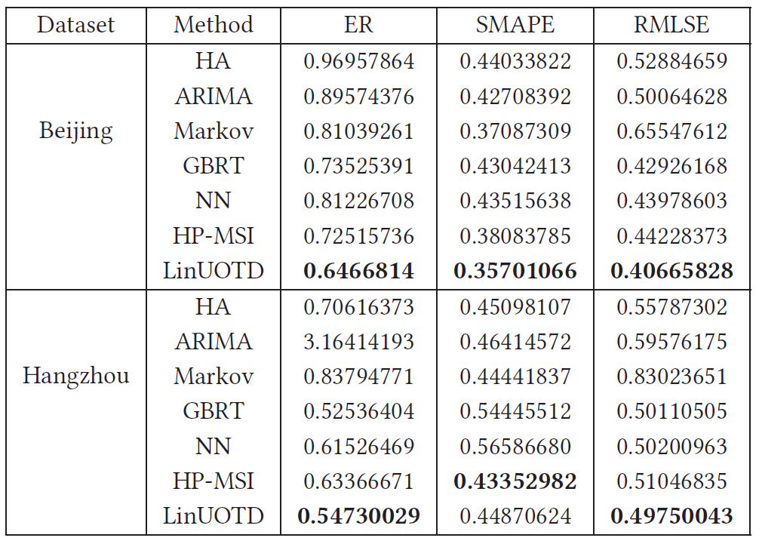
Experimental Study
Notes:
Here are the main results. Our method is denoted as LinUOTD, which refers to a linear prediction model for UOTD.

Slide 46
Experimental Study
HA performs poorly on both datasets
Notes:
We have the following observations. First, HA performs poorly on both datasets.

Slide 47
Experimental Study
Sometimes ARIMA and Markov are worse than HA
Notes:
Second, sometimes ARIMA and Markov are even worse than the naive HA method.

Slide 48
Experimental Study
Time-series methods may ignore the spatial variations of UOTD
Notes:
A possible reason might be that time-series methods ignore the spatial variations of UOTD.

Slide 49
Experimental Study
NN and GBRT are competitive
Notes:
Third, NN and GBRT are two competitive methods.

Slide 50
Experimental Study
Supervised non-linear models that extract spatiotemporal features from heterogeneous data
Notes:
The reason may be that these two methods are supervised non-linear models and are able to extract spatio-temporal features from multiple heterogeneous data sources.

Slide 51
Experimental Study
Methods for spatiotemporal prediction (HP-MSI and LinUOTD) achieve the best overall performance
Notes:
Finally, methods tailored for spatio-temporal prediction (HP-MSI and our LinUOTD) achieve the best overall performance.

Slide 52
Experimental Study
LinUOTD outperforms HP-MSI in almost all the metrics on the two datasets
Notes:
And LinUOTD outperforms HP-MSI in almost all the metrics on the two datasets.

Slide 53
Outline
Background and Motivation
Key Methodology
Feature Engineering
Our Model
Model Training Processing
Experimental Study
Conclusion
Notes:
This is the outline

Slide 54
Conclusion
Adopt a linear model with high-dimensional features in predicting UOTD, which transforms model redesign to feature redesign
Apply a distributed learning framework to support rapid, parallel and scalable feature updating and testing
To be fit for UOTD prediction, a spatio-temporal regularizer is designed
Extensive evaluations on two large-scale datasets from an industrial online taxicab platform validate the effectiveness of our approach

Slide 55
Thank You!
Notes:
Thank you very much！

Slide 56
Experimental Study
Unstable accuracies in different regions and unsatisfactory accuracies on large-scale datasets
Notes:
They tend to yield unstable prediction accuracies for different regions and thus unsatisfactory overall performance on large-scale datasets.

